Slide 1

WELCOME TO
THE UPPER ROOM CHURCH
Health Expo & Seminar Series

Slide 2
Day 1 Monday 26th August
Choosing to live longer, better…
George Mabeza

Slide 3
Outline
Introduction
Blue Zones
5 steps (change)
Questions

Slide 4
Introduction…

Slide 5
The truth about aging…
‘Holy Grail’, ‘Fountain of Youth’, ‘Magic source of long life’
      the fabled spring of water that can bestow everlasting life
Idea persists
  ‘Charlatans and fools’
  vested interests (pharmaceutical/beauty products companies, medical profession, alternative health practitioners etc)
  pill, diet or medical procedure

Slide 6
The truth about aging…
“What does the worker gain from his toil? I have seen the burden God has laid on men. He has made everything beautiful in its time. He has also set eternity in the hearts of men; yet they cannot fathom what God has done from beginning to end. I know that there is nothing better for men than to be happy and do good while they live. That everyone may eat and drink, and find satisfaction in all his toil—this is the gift of God.”
    Ecclesiastes 3:9-13

Slide 7
The truth about aging…
What exactly is aging?
Is your age predetermined?
    Hard-wired or written in our genes?
    Genetic clock?
    Accumulation of toxins?
    Heart rate?

Slide 8
Is there an optimal formula for longevity?
What really makes us live longer, better?

Slide 9
The truth about aging…
Danish twin studies:
The heritability of human longevity: a population-based study of 2872 Danish twin pairs born 1870-1900. Hum Genet 1996 1996 Mar;97(3):319-23
  Only about 10% of how long we live is dictated by our genes
  The other 90% is determined by our lifestyles and the everyday choices we make

Slide 10
The missing years…
    capacity for the human body is about 90 years
      12 missing years
      largely free of chronic disease (heart disease, cancer and diabetes)
Cultures around the world
  Live to age 100 (rate 10x than we are)
  Life expectancy is extra 12 years
  Middle aged mortality a fraction
  LONGEST DISABILITY FREE LIVES

Slide 11
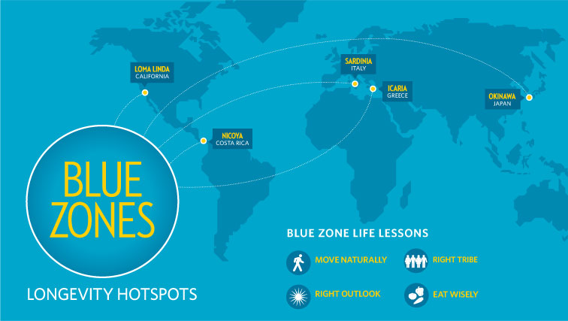

Slide 12
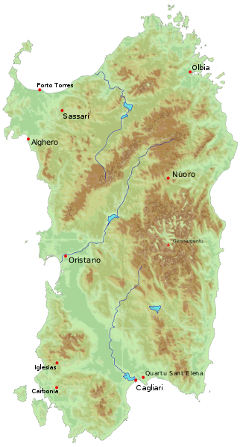

Slide 13
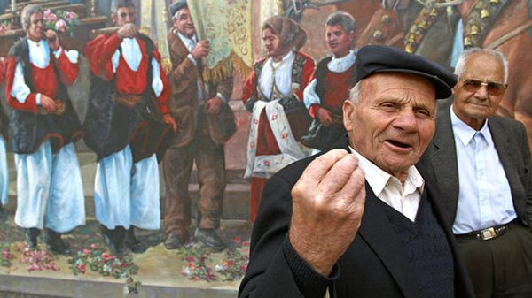

Slide 14
SARDINIA
Men live the longest!!!
  with extraordinary vigour
  largely shepherds, regular low-intensity physical activity
  plant based diet (if meat lean, organic)
  unleavened wholemeal bread
  goat cheese (grass v corn fed)
  Cannanou wine
  Grandmother effect
    Family & society (4-6 years to life)
    Good for the older people and children
Notes:
125 miles of coast of Italy
Highlands, bronze age culture, life has been much the same since the time of Christ
No word for retirement – lifelong activity/work… patient story
Still head sheep, chop wood, ride motorcyles, die in their 90 often sex

Slide 15
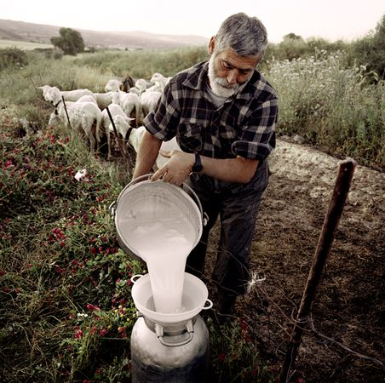
Notes:
Sunlight/ vit D calcium, fresh air, sleep better, melatonin

Slide 16
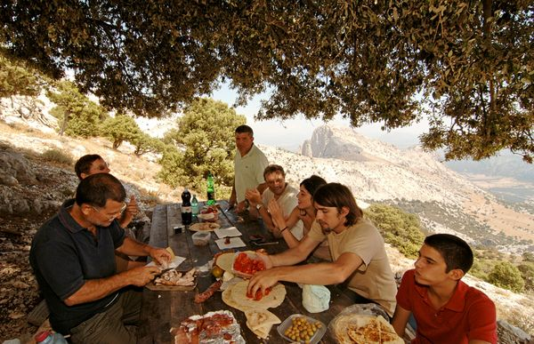
Notes:
family

Slide 17
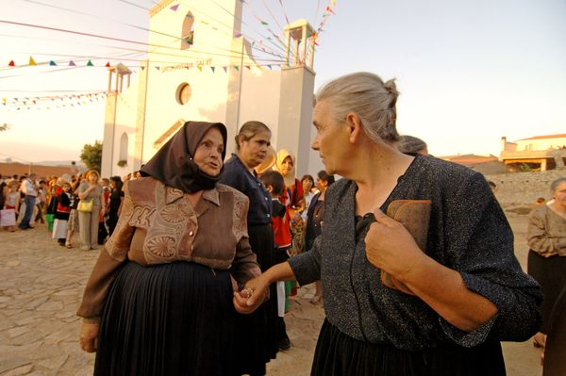
Notes:
Isolation kills…
We are social beings… we need to belong/to feel loved and appreciated

Slide 18
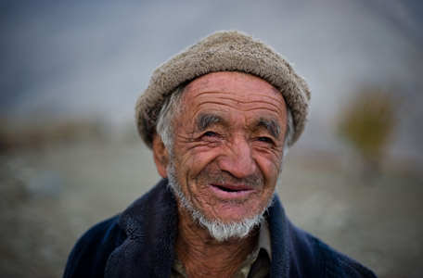

Slide 20
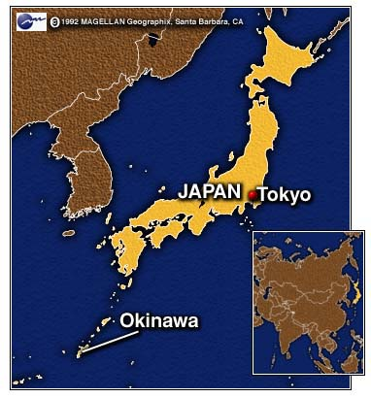

Slide 21
OKINAWA
800 miles south of Tokyo
Oldest living female population
5 times as many centenarians
Longest disability-free lives
  20% breast and colon cancer rates
  1/6 the rate of cardiovascular disease
Notes:
161 small islands, northern part
Ground zero for longevity

Slide 22
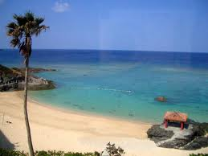

Slide 23
What do they do?
Plant based diet
  lots of colour in diet
  8x as much tofu
How they eat it
  Smaller plates
  Serve at counter and bring it to the table
  3000 y old adage ‘Hara hachi bu’
‘Moai’
  Isolation kills
No word for retirement
‘Ikigai’
Notes:
Eat until you are 80% full, 20 mins
America – 2 friends

Slide 24
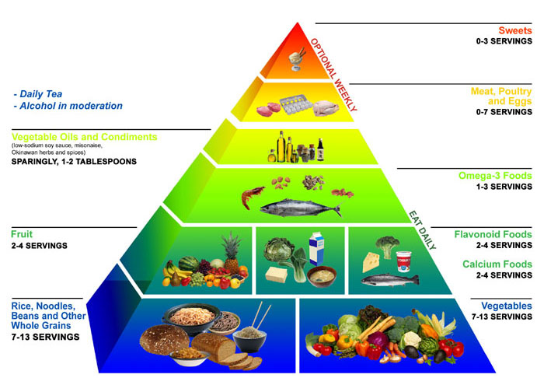

Slide 25
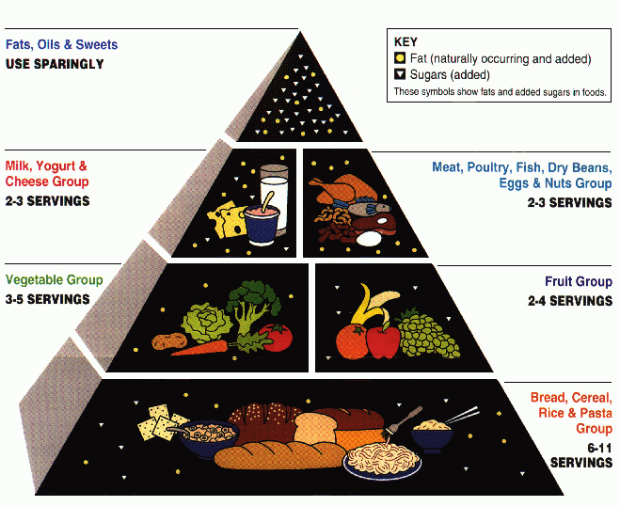

Slide 27
SEVENTH-DAY ADVENTISTS
‘Heterogenous group’
  70 000 people for 30 years
  average woman life 89 years (80)
  men live 11 years longer
diet from the Bible (Gen 1:26)
24 h sanctuary in time
  Focus on God
  Focus on relationships
company they keep
nature walks

Slide 28
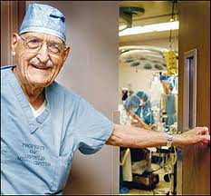
Ellsworth Wareham

Slide 30
So what are the common denominators?
Notes:
change

Slide 31
1. MOVE NATURALLY…
“None of them exercise – instead they are active without having to think about it”
their lives are set up for constant activity
    sit on floor (Okinawa)
    hilly terrain, vertical houses (Sardinia)
    nature walks (Adventists)
    walk and cognitive decline
    Gardening
    SIMPLICITY
‘NEAT’
  easychair is a killer!
  UK, walking disappearing

Slide 32
Suggestions…

Slide 33
Suggestions…
moderate and sustained activity
  regular low-intensity activity
aerobic, balancing and muscle-strengthening
  flexibility and falls
  stand on one foot when brushing teeth!
at least 30 min (ideally 60) 5 times per week
  sleep, depression, mood, immunity

Slide 34
2. ‘Hara Hachi Bu’…
Painlessly cut calories by 20%
Calories and cellular damage from free radicals
Lose weight (positive effect on BP and cholesterol)
paradox of diets
  ‘fat-free diets’

Slide 35
Suggestions…

Slide 36
Suggestions…
no diet, work on long term
small plates and glasses
caloric density (volume better than calories)
  serve and store food
  make food look bigger
  make snacking a hassle
  buy smaller packaging
  eat more slowly (and chew properly)
  focus on food
  have a seat

Slide 37
3. Plant based diet…
  avoid meat and processed food
  the protein question
  Genesis 1:29 “Behold, I have given you every plant yielding seed that is on the surface of all the earth, and every tree which has fruit yielding seed; it shall be food for you”

Slide 38
4. Belong…
  ‘isolation is harmful’
  Family and social support
  We need to feel accepted, love and appreciated

Slide 39
5. Right attitude…
  Downshift (take time out)
  Purpose
    vocabulary for a sense of purpose
    ‘Ikigai’
  Prayer
  stress, inflammatory response and disease
    (vitamin s)

Slide 40
Summary…
3 John 2: ‘Dear friend, I pray that you may enjoy good health and that all may go well with you, even as your soul is getting along well”

Slide 41
Tomorrow’s talk…
“Optimal nutrition for health and how to reduce the risk of diabetes”

Slide 42
Are there any questions?

